Slide 1



Water Quality Prediction
Musturu Sindhu
Student ID: STU679fa85be476c1738516571

Slide 2

Learning Objectives
Understand water quality indicators and their environmental impact
Apply data preprocessing techniques to environmental datasets
Build a multi-output machine learning model to predict pollutant levels
Develop a Streamlit app for user-friendly prediction
- Deploy a real-time application simulating smart environmental monitoring
GOAL
Source :
www.freepik.com/

Slide 3
Tools and Technology used
Python
Pandas, NumPy
Scikit-learn (Random Forest, MultiOutputRegressor)
Joblib (model saving)
Streamlit (for frontend app)
- Jupyter Notebook (development)

Slide 4
Data Collection and Cleaning: Water quality data was collected and missing values were
cleaned to ensure model performance.
Feature Engineering: Focused on two primary features —Year and station Id known to influence pollutant levels.
Categorical Encoding: The. station Id , being categorical, was transformed using
One-Hot Encoding to be fed into the model.
Model Selection: A multiOutputRegressor wrapping a RandomForestRegressor was
selected for its ability to predict multiple outputs and handle non-linear relationships.
.
Model Training & Saving: The model was trained on historical data and saved using joblib.
Frontend Integration: A Streamlit app was developed to provide a simple interface for users
to make predictions without technical knowledge.
Methodology

Slide 5
Problem Statement:
Manual water quality assessment is slow, expensive, and not scalable. Authorities often lack real-time visibility into changing pollutant levels, which may lead to delayed responses and environmental harm.
The project aims to solve this problem by using AI-powered prediction models that provide instant pollutant forecasts using simple inputs like year and station ID.

Slide 6
Solution:
This project presents a web-based prediction system that uses a trained machine learning model to forecast multiple pollutants.
The application:
Accepts inputs from the user via a web interface (year and station ID).
Encodes the inputs and feeds them to a pre-trained model.
Outputs predicted levels of 6 pollutants.
This AI-driven approach offers speed, accuracy, and scalability, making it ideal for smart city environmental monitoring.

Slide 7
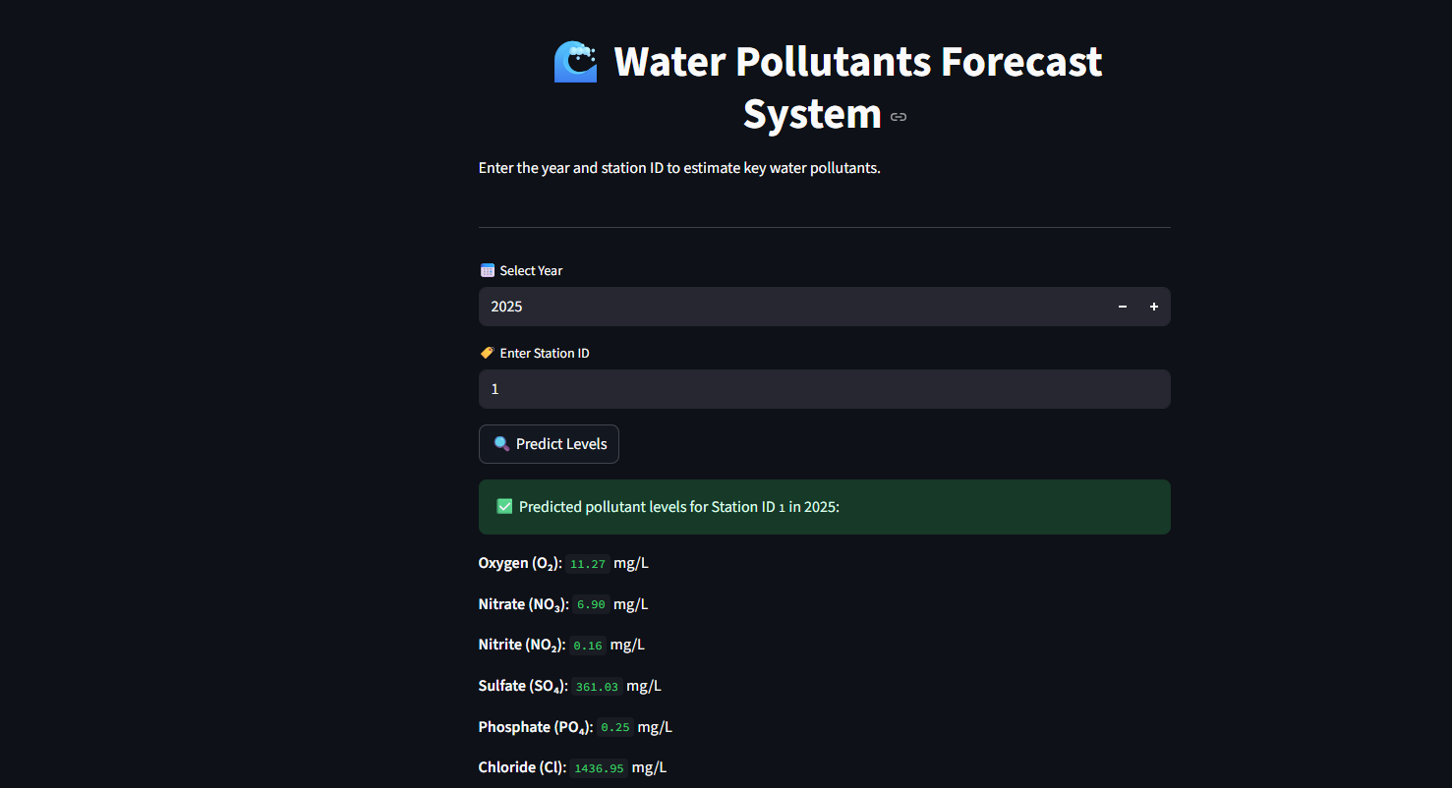
Screenshot of Output:

Slide 8
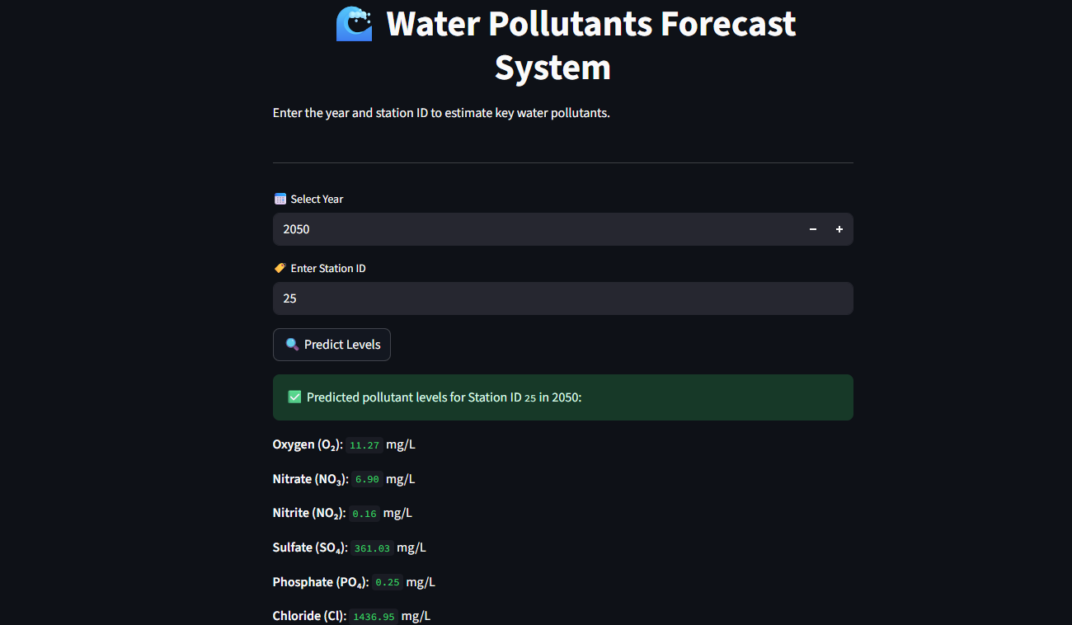
Screenshot of Output:

Slide 9
Conclusion:
The Water Quality Prediction System provides a practical demonstration of how artificial intelligence can be applied to solve real-world environmental issues. By predicting pollutants early, this solution helps:
Protect aquatic ecosystems
Ensure safe drinking water
Support smart city planning It combines machine learning, data visualization, and modern app development to deliver a meaningful societal impact through technology.
GitHub: https://github.com/Sindhureddy2326/Water-Quality-Prediction---RMS

